Slide 1

Electric Vehicle Analysis
Sajan Kumar Kar
Pratiksha Dange

Slide 2





What is an Electric Vehicle?
Powered by an electric motor
Replaces fuel with a chargeable battery
Idea is to lower fuel costs and reduce emissions.

Slide 3
Data Description
Our dataset is found from the vehicles registered under the Department of Licensing of Washington State.
177,866 Records and 17 Features
Features: Vehicle Identification Number (VIN), county, city, state, postal code, model year, make, model, electric vehicle type, Clean Alternative Fuel Vehicle (CAFV) eligibility, electric range, base Manufacturer's Suggested Retail Price (MSRP), legislative district, Department of Licensing (DOL) vehicle ID, vehicle location, electric utility, and 2020 Census Tract.

Slide 4

Relevant Features
Make - Brand
Model – The specific model
Electric Vehicle Type – All Electric or Plug-in Hybrid
CAFV Eligibility – Clean Alternative Fuel Vehicles eligibility
Electric Range – How far a vehicle can travel on its electric charge
Electric Utility – Electric power retail service territories serving the address of the vehicle registered

Slide 5
EDA: Descriptive Analysis
Top Model | Tesla Model Y
No. Of Counties | 187
No. Of Cities | 704
No. Of Brands | 39
Top Brand | Tesla
Max Electric Range | 337
Place with the most EVs | Seattle, King County

Slide 6
EDA: Data Cleaning
Identifying the missing values
Handling Missing Records
Addressing 'Electric Utility' Values
Reducing 'Electric Utility' Categories
Feature Name and Values Mapping

Slide 7
Analysis - 1
Q1: What is the relationship between the Electric Vehicle type, CAFV eligibility and the electric utility?

Slide 8
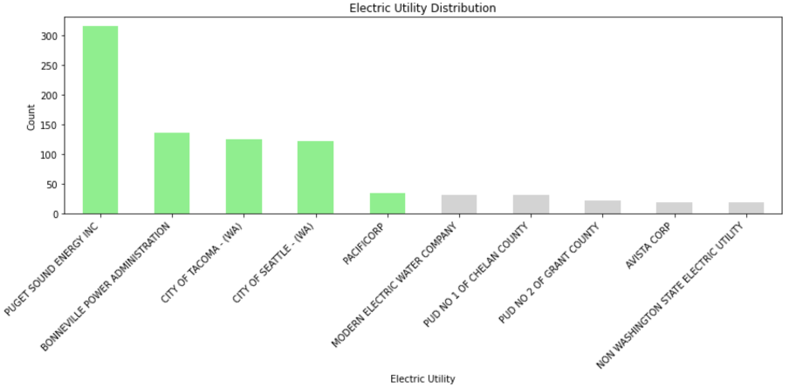
Puget Sound energy Comes at the top
Bonneville, Tacoma and Seattle take the next positions but consist of almost half the territories.

Slide 9
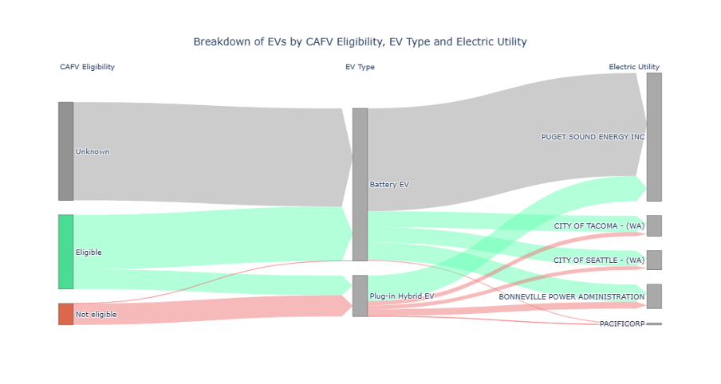

Slide 10
Key findings
Most Battery EVs have unknown CAFV eligibility and are linked with Puget Sound Energy Inc.
CAFV-eligible Battery EVs are primarily distributed among City of Tacoma, City of Seattle, and Bonneville Power Administration utilities.
The majority of CAFV-eligible Plug-in Hybrid EVs are associated with Puget Sound Energy Inc.
Non-eligible CAFV EVs are mainly Plug-in Hybrid EVs, except for some Battery EVs which are associated with PacifiCorp.

Slide 11
Analysis - 2
Q2: What is the distribution of electric vehicles across different counties and cities and are there any notable patterns or concentrations?

Slide 12
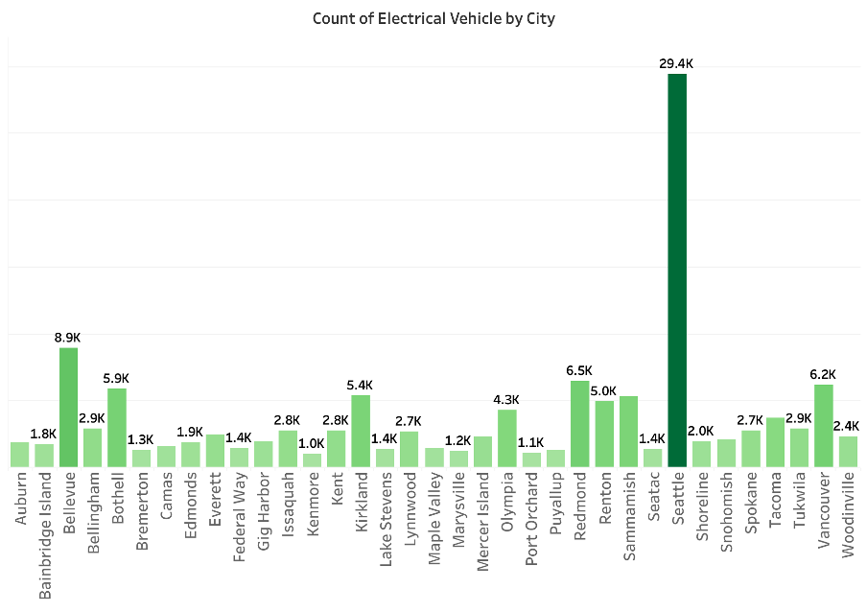
Seattle's High EV Concentration
Moderate EV Distribution:
Bellevue, Redmond, Vancouver, Sammamish, Kirkland, Renton, Bothell, and Olympia
Variance Across Cities

Slide 13
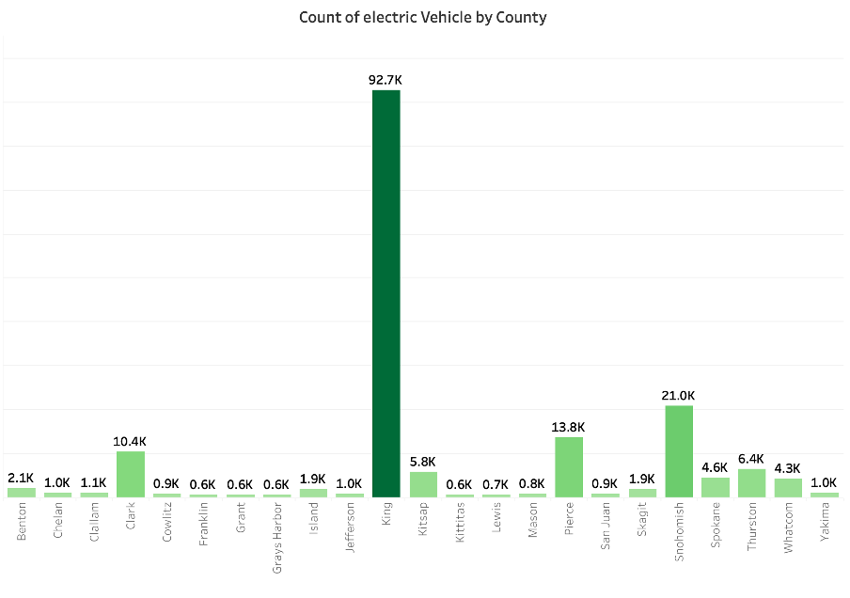
King County: Highest EV count
Other Counties: Snohomish, Pierce, Clark, Thurston, and Kitsap follow with significant but lower EV counts.

Slide 14
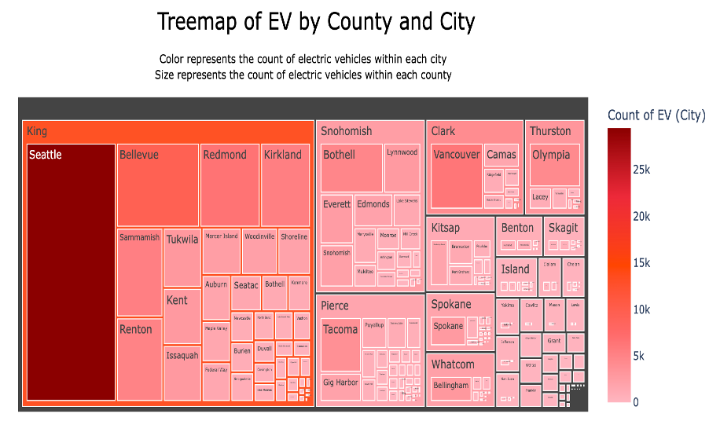
City-Level Concentration​
County-Level Distribution​
Comparative Analysis​
Data Density and Urban Centers​
Rural vs. Urban Spread​

Slide 15
Analysis - 3
Q3: What insights can we gain about the future of electric mobility by examining the data on newer models and their technological features? For instance, how are factors like electric range and Electric vehicle type evolving with advancements in electric vehicle technology?

Slide 16
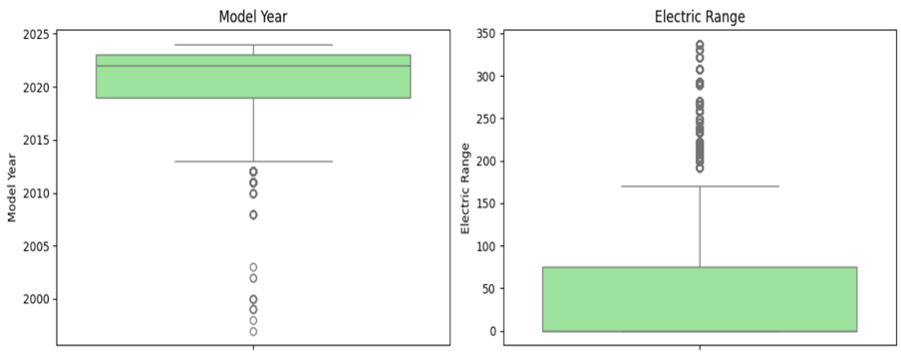
Model Year :
Dominated by recent models, with early outliers revealing pre-2000 models.
Electric Range:
General models offer below 100 electric range.

Slide 17
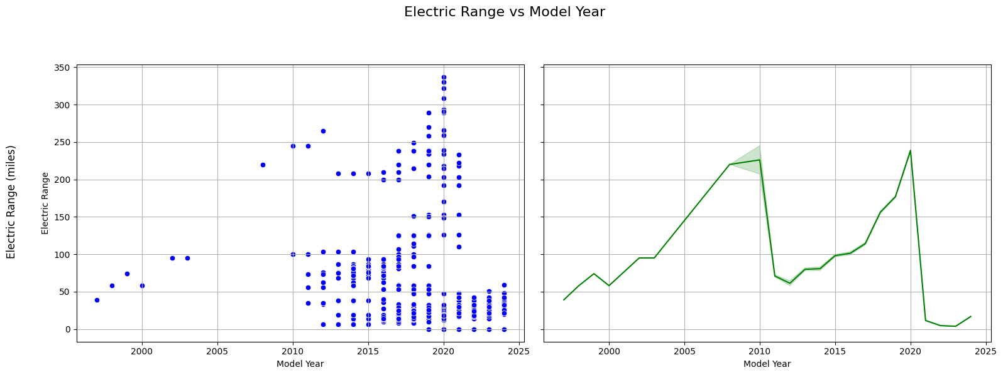
Post 2015, we notice EV models offering above 200 electric range
Upward trend overall in Electric Range
Massive drop in 2010.

Slide 18
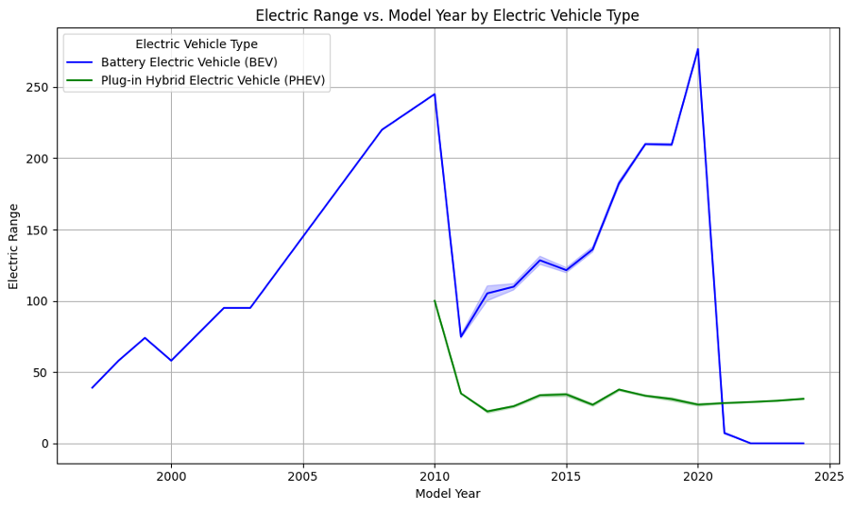
BEVs: Recent Decline in BEVs
Significant increase in range post-2010
PHEVs: Less variability and gradual improvements
Market Differences for BEVs and PHEVs

Slide 19
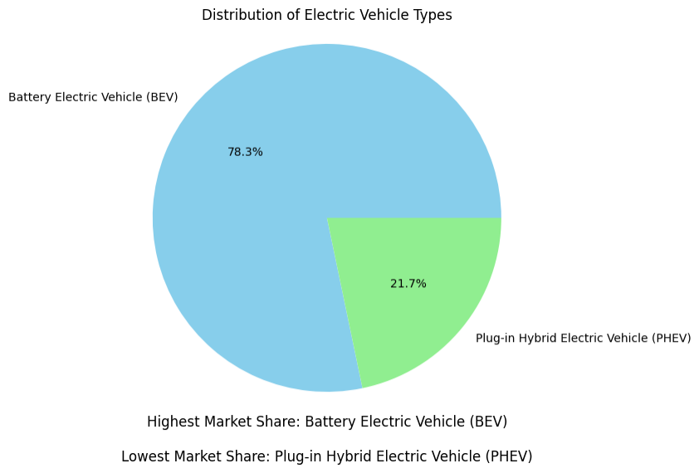
BEVs Market Share: 78.3%
PHEVs Market Share: 21.7%
Popularity and Availability: The significant gap between BEVs and PHEVs

Slide 20
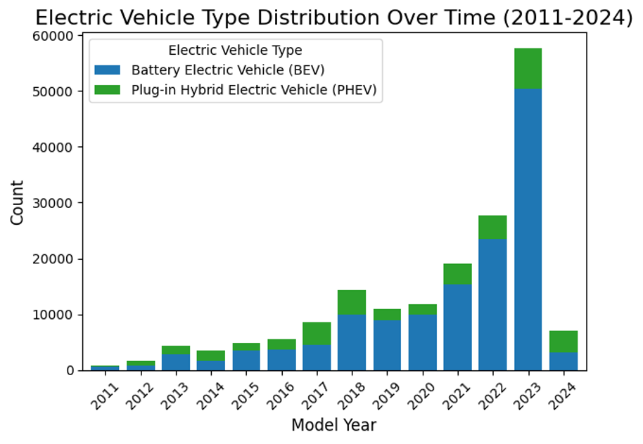
Growth trends of BEVs and PHEVs over various model years.
Notable increase in BEV counts, particularly a sharp rise post-2020.
PHEVs show less growth compared to BEVs, indicating a shift towards favoring BEVs.
Recent Surge in BEVs suggests increased production and adoption.

Slide 21
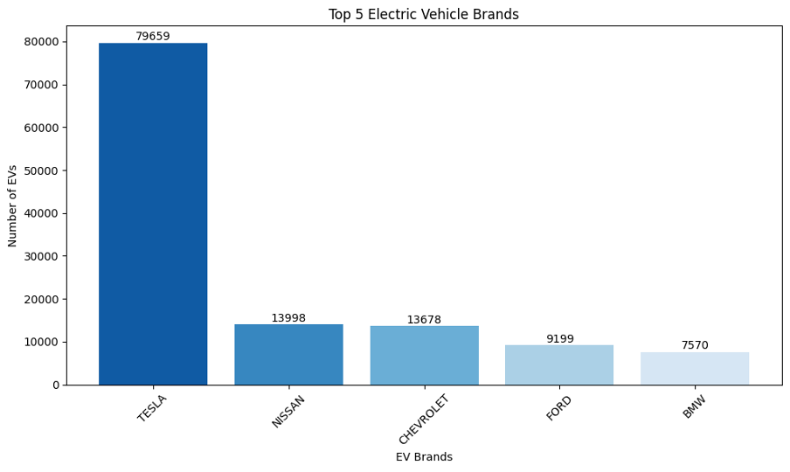
Market Leader: Tesla
Brand Hierarchy: There is a sequential decrease in EV counts from Tesla to BMW

Slide 22
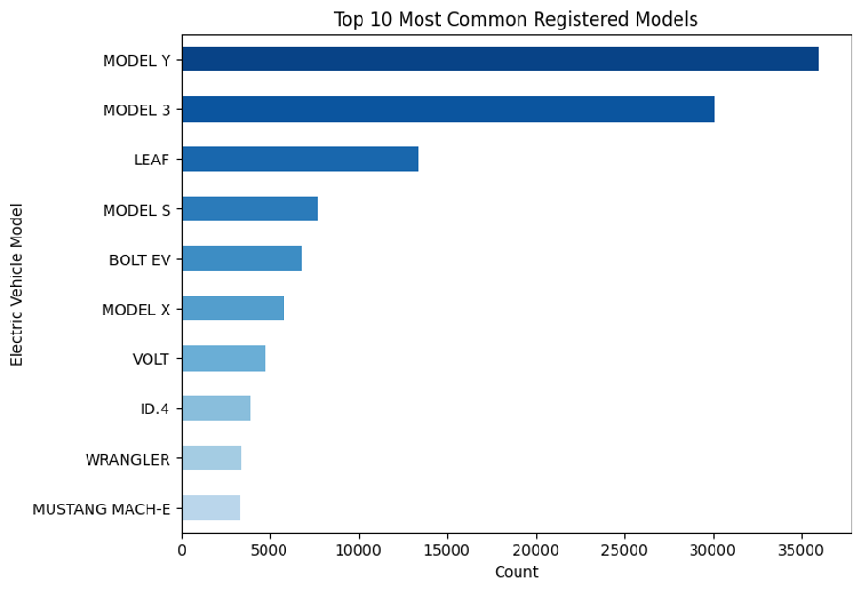
Top Model: Model Y is most prevalent, shown in the darkest blue.
Leading Models: Followed by Model 3, LEAF and others in descending order of frequency.
Least Common: Mustang Mach-E appears as the least common among the top ten.

Slide 23

Major findings
The dataset mainly includes recent models, with few older models before 2010 indicating limited early electric vehicles.
EV counts were increased over the time
Noticeable drop in recent model year's range and then surge in BEVs need investigation
Electric range is noticeably high in newer models
Tesla is the topmost brand in EV
Model Y is the topmost model in EV

Slide 24
Limitation And Future scope
Geographic Scope: The study is limited to Washington state, reducing the broader applicability of the findings and hindering insights into national and regional EV market trends.
Detailed Pricing Analysis: 75th percentile of `Base MSRP` is 0.
Extended Geographic Analysis: Nationwide data

Slide 25

conclusion
Buy a Tesla (Model Y)

